Slide 1
Auditing the Justice of the Peace Office
TACA Spring Conference – April 2024

Slide 2
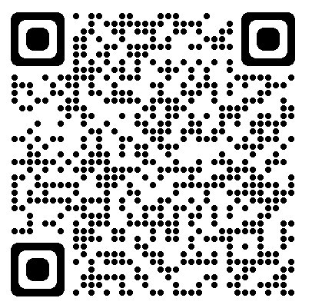
TACA Talk Trivia
Auditing the Justice of the Peace Office

Slide 3
INTRODUCTIONS
Kim Trussell
Internal Audit Manager
16 years with Tarrant County AO
Kara Hoekstra
Technology & Advisory Audit Manager
8 years with Tarrant County AO

Slide 4
Overview
Understanding JP Operations
Statutes for the Auditor
Performing an Audit
Additional Resources

Slide 5
JP Trivia
TRUE or FALSE
An 18-year-old high school student is eligible to run for JP so long as they have been a Texas resident for 12 months, a District resident for 6 months, and are registered to vote in the area of office sought.
TRUE
Texas Secretary of State

Slide 6
JP Trivia
YES or NO
Does a JP need to have a license to practice law?
NO
Texas Secretary of State

Slide 7
JP Trivia
YES or NO
Do JP courts have jurisdiction over civil matters in which the amount in controversy is $20,000 or less?
YES
Government Code 23.031(a)(1)

Slide 8
JP Trivia
TRUE or FALSE
A JP is authorized to perform wedding ceremonies under the Texas Family Code.
TRUE
Family Code 2.202

Slide 9
JP Trivia
YES or NO
Is a JP required to remit a portion of their fees for wedding ceremonies to the county?
NO
LGC 154.005(a)

Slide 10
Understanding JP Operations

Slide 11
Understanding JP Operations
The Texas Constitution provides that each county shall have one to eight justice precincts depending on population. The major responsibility of the office is to preside over the justice court, which also may function as a small claims court.
A Justice of the Peace is elected from each precinct in the county and serves a four-year term until a qualified successor is elected.

Slide 12
Understanding JP Operations
Justice of the Peace courts have jurisdiction over criminal and civil cases (claims not over $20,000) as well as other non-judicial duties.
Other non-judicial duties include:
Inquests and hearings (dead body, fire, unsafe driver)
Marriage ceremonies
Ex officio notaries public
Registrar of Vital Statistics
(can be County Clerk per Health and Safety Code 191.022)

Slide 13
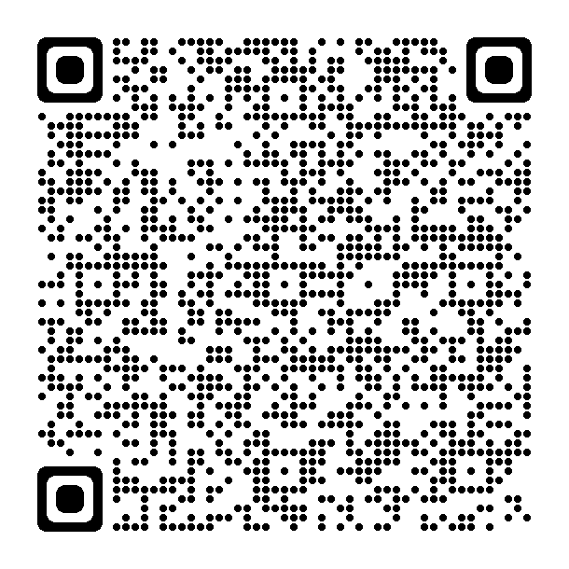
Understanding JP Operations
More information on JP jurisdiction and responsibilities can be found in the 2021 Guide to Texas Laws for County Officials, published by the Texas Association of Counties.
Prepared by David B. Brooks
Quick Reference Guide (not all inclusive)
Description of office and duties

Slide 14
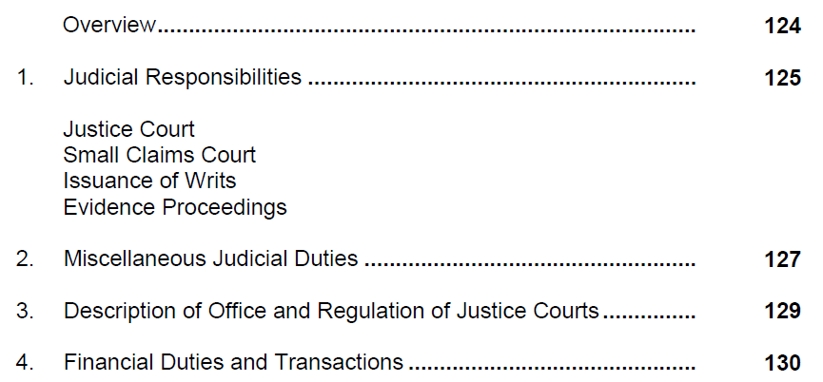
Understanding JP Operations
Source: 2021 Guide to Texas Laws for County Officials, Texas Association of Counties

Slide 15
Statutes for the Auditor

Slide 16
Statutes for the Auditor
The county auditor has oversight of the books and records of a county officer authorized to receive and collect money, as well as oversight of property used for or belonging to the county. Additionally, it is our responsibility to ensure enforcement of the laws concerning county finances. (LGC, Sec. 112.006)
The county auditor “shall” examine the accounts, dockets, and records of officials collecting money, including the justice of the peace, and determine whether money belonging to the county has been accounted for and paid over according to law. If we find that moneys are unaccounted for and not paid over, we are to report the finding to commissioners court to go forward with recovery. (LGC, Sec. 115.901)

Slide 17
Statutes for the Auditor
At least once each county fiscal year, the auditor “shall” fully examine the accounts of all precinct, county, and district officials without advance notice. The auditor “shall” verify the correctness of the accounts and report the findings to commissioners court. (LGC, Sec. 115.0035)
The county auditor “shall” determine the frequency and method of reporting by the fee offices and the manner for making an annual report of fees collected and disbursed. (LGC, Sec. 114.002)
In counties with a population of 190,000 or more, the auditor “shall” audit, adjust, and settle the accounts of the district attorney, the district clerk, and each county or precinct officer. (LGC, Sec. 115.004)

Slide 18
Performing an Audit

Slide 19
Performing an Audit
When to Audit
According to the audit plan
To meet statutory requirements
Elected or county official requests
Fraud or wrongdoing is suspected
Key personnel retires or terminates

Slide 20
Performing an Audit
Plan the Audit
Determine the type of audit being performed
Statutory compliance
Financial controls
Security controls
Determine the audit scope (full or limited)
Determine the time period
Fiscal year ended
Quarter ended
As of date
Communicate with the JP
Perform an internal control / risk assessment

Slide 21
Performing an Audit
Areas of Risk
Assessment of Fees
Collection and Recording of Receipts
Voids, Credits, Adjustments
Deposits
Disbursements

Slide 22
Performing an Audit
Areas of Risk
Assessment of Fees
The amount is assessed/collected does not comply with
statute.
Fines, Fees, and Costs Deskbook @ https://www.tjctc.org/tjctc-resources/deskbooks.html

Slide 23
Performing an Audit
Areas of Risk
Receipts are not recorded.

Slide 24
TACA Talk Joke
Why are auditors so cool, calm, and collected?
Because they have
internal controls.

Slide 25
Performing an Audit
Areas of Risk
Voids, Credits, Adjustments
Segregation of duties do not exist.
Documentation supporting the transaction does not exist.
There is no independent review of the transaction.
Procedures are not standardized among justice courts.

Slide 26
Performing an Audit
Identify Areas of Risk
Deposits
Segregation of duties do not exist.
Funds are not deposited into the JP’s bank account timely.
Funds are not remitted to the county treasurer in accordance with
statute.
LGC Sec. 113.022 states that funds must be deposited with the county treasurer no later than the 5th business day after receipt of the funds.

Slide 27
Performing an Audit
Identify Areas of Risk
Disbursements
Segregation of duties do not exist.
Disbursements from the JP’s bank account do not reconcile to the case management system.
Disbursements are not properly supported.
Disbursements do not comply with relevant statutes or policies.

Slide 28
Performing an Audit
Additional Controls
Security Authorizations to Computer Systems
Financial Reporting
Bank Reconciliations
Staffing

Slide 29
Performing an Audit
Additional Controls
Security Authorizations to Computer Systems
Policy prohibiting sharing of passwords
Complex, protected, and kept confidential
Review system permissions relevant to job duties
Segregate job duties with permissions
High risk transactions should be limited
Secondary approval of voids
Requiring reasons and comments for adjustments
Audit logs

Slide 30
Performing an Audit
Additional Controls
Financial Reporting
Receipts and Deposits
Issued sequentially
Receipt totals should match deposit totals
Tender methods recorded should match deposits
Disbursements
Review payees for reasonableness
Review check register for missing or voided checks
Sample voids, adjustments, and credits
Test a sample
Perform data analytics
JP’s signature on reporting for evidence of review

Slide 31
Performing an Audit
Additional Controls
Bank Reconciliations – Official holds bank account
Receipts recorded agree with bank statement (consider deposits in transit)
Accuracy of reconciling items
Prior reconciling items have cleared
Composition of amounts held in the registry

Slide 32
Performing an Audit
Additional Controls
Staffing
Rotating duties among staff
Enforcing vacations
Exit reviews

Slide 33
Helpful Resources

Slide 34
Helpful Resources
Texas Constitution, Statutes, AG Opinions
Texas County Auditor Handbook
Texas Justice Court Training Center Deskbooks
Fines, Fees, and Costs
Evictions
Criminal
Civil
2021 Guide to Texas Laws for County Officials
2023 Oath and Bond Requirements for County Officials
County / Department Policies and Procedures

Slide 35
QUESTIONS?

Slide 36
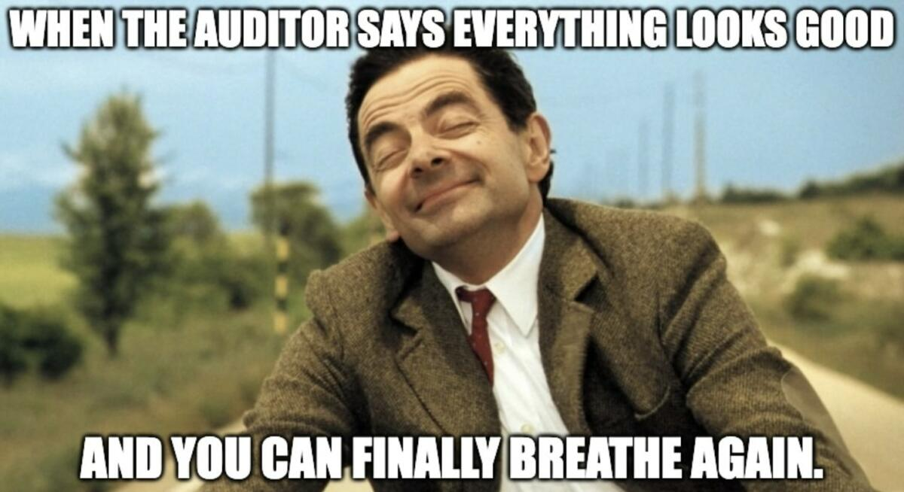
TACA Talk Joke

Slide 37
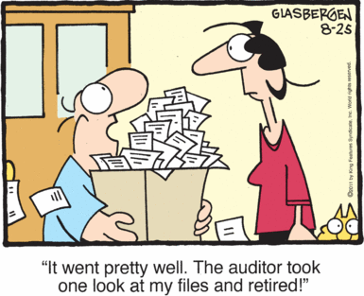
TACA Talk Joke

Slide 38
Contact Information
Kim Trussell Kara Hoekstra
817-884-1010
kdtrussell@tarrantcountytx.gov
817-884-2614
kdhoekstra@tarrantcountytx.gov

