Slide 1
Truth in Taxation
Pulling Back the Curtain on TNT for the COUNTY

Slide 2
NNR & VAR
NNR – The tax rate that produces the same revenue you got last year when taxing properties that are taxed in both years.
VAR – The highest tax rate you can adopt without having an election.

Slide 3
NNR
The tax rate you need to adopt to get the same amount of revenue this year that you got last year
VAR
Last year’s M&O Revenue + 3.5% + Debt Rate
TAXABLE VALUE
NNR AND VAR TAX RATES

Slide 4
What do we all need to do to get it done?
DESIGNATE AN OFFICER OR EMPLOYEE TO CALCULATE THE RATES
GATHER THE RIGHT INFORMATION
GET THE CALCULATIONS DONE ON TIME – AUGUST 7
POST THE RATES – NEWSPAPER AND WEBSITES
ADOPT THE TAX RATE – SEPTEMBER 30
DON’T GET SUED

Slide 5
Designate an officer or employee
26.04 (c) – After the assessor submits the appraisal roll, an officer or employee designated by the governing body shall calculate the no-new-revenue and voter-approval tax rate.

Slide 6
GATHER THE RIGHT INFORMATION
FROM THE APPRAISAL DISTRICT:
LAST YEAR’S VALUE AND TAX CEILINGS – 1 & 2
TAXABLE VALUE LOST TO COURT DECISIONS - 5
TAXABLE VALUE THAT IS BEING LITIGATED – 6 & 7
VALUE LOST DUE TO FIRST-TIME EX OR AG – 10 & 11
CAPTURED VALUE IN A TIF OR TIRZ - 13
THIS YEAR’S CERTIFIED VALUE AND CHIEF APPRAISER’S OPINION OF VALUE UNDER PROTEST – 18

Slide 7
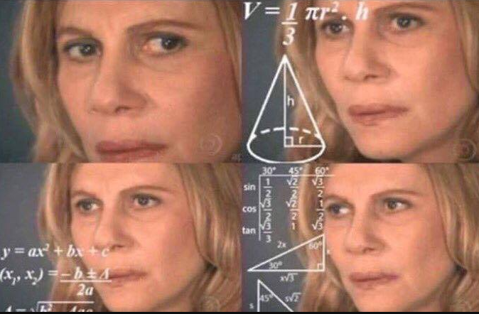
Gather the right information
APPRAISAL DISTRICT CON’T.:
RAILROAD ROLLING STOCK – 18
VALUE UNDER PROTEST – 19
CURRENT YEAR TAX CEILINGS – 20
VALUE OF NEW IMPROVEMENTS AND NEW BPP - 23

Slide 8
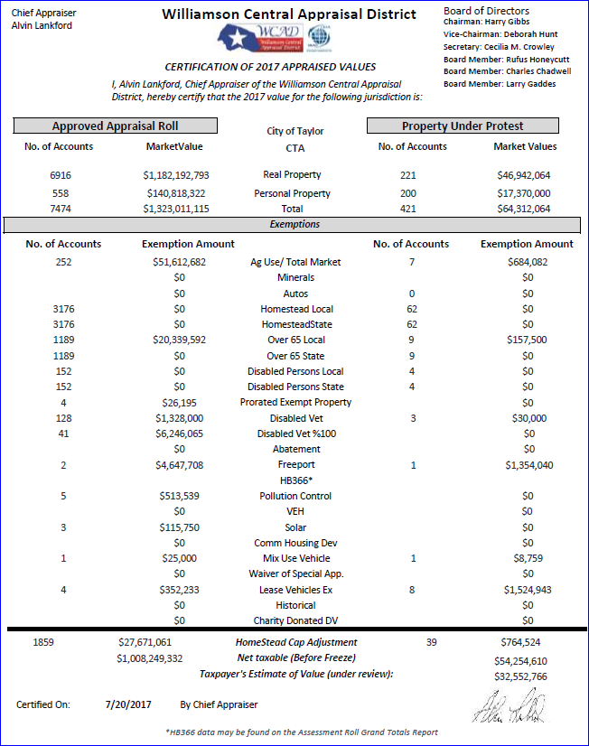

Slide 9
Gather the right information
FROM THE COUNTY AUDITOR:
CAPTURED APPRAISED VALUE IN A TIF - 13
TAXES PAID INTO A TIF - 31
INCREASE IN STATE CRIMINAL JUSTICE MANDATES - 34
INCREASE IN INDIGENT HEALTHCARE - 35
INCREASE IN INDIGENT DEFENSE - 36
COUNTY HOSPITAL EXPENDITURES - 37

Slide 10
Gather the right information
COUNTY AUDITOR CON’T.:
SALES TAX SPENT ON M&O - 40
DEBT PAYMENTS, UNENCUMBERED FUNDS TO BE USED TO PAY DEBT - 42
AMOUNT FROM OTHER SOURCES - 42
CERTIFIED AMOUNT FROM SALES TAX – SECTION 3

Slide 11
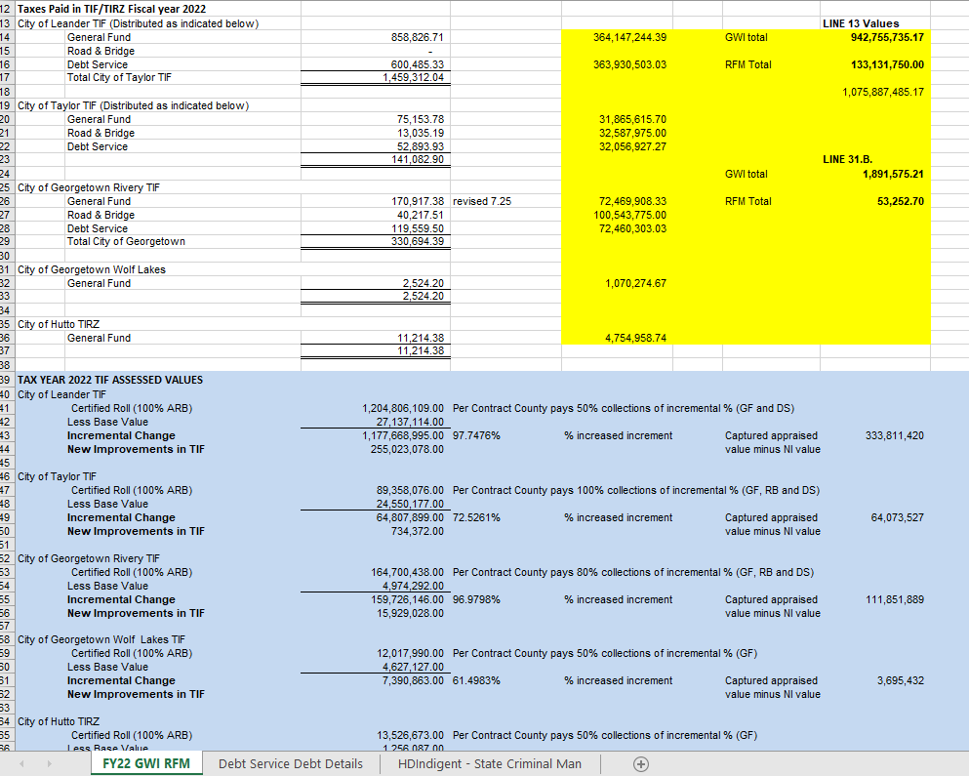

Slide 12
Gather the right information
FROM THE TAX ASSESSOR-COLLECTOR
TAXES REFUNDED FOR PRIOR YEARS – 16 & 31
PRIOR YEAR EXCESS DEBT COLLECTIONS - 43
ANTICIPATED COLLECTION RATE - 45
UNUSED INCREMENT RATES – Section 5 changes

Slide 13
GettinG THE DATA AND DOING THE WORK
THE SOONER THE BETTER
ORGANIZED AND CONSISTENT
CHECK EACH OTHERS WORK
ASK IF SOMETHING DOESN’T LOOK RIGHT

Slide 14
AUGUST IS BUSY
CALCULATE TAX RATES
PROPOSE A TAX RATE
SET PUBLIC HEARING AND RATE ADOPTION DATE
PUBLISH A NOTICE
POST ON THE COUNTY WEBSITE AND PROPERTY TAX DATABASE WEBSITE

Slide 15
Attention commissioners and judges
PROPOSE A RATE AND DATE TO ADOPT
ADOPT RATES SEPARATELY
SAY THE SPECIAL WORDS
MAYBE ADOPT BUDGET &
TAX RATE AT SAME MTG

Slide 16
Let’s talk about it
LY TAXABLE VALUE MINUS APPEALS – LINES 1 & 6
CHIEF APPRAISER’S OPINION OF VALUE – LINE 19A
THE LITTLE SECRET ABOUT TAX CEILINGS
PROPERTY TAX DATABASE DIRECTORY – Texas.gov/PropertyTaxes
POST EVERYTHING ON A WEBSITE

Slide 17
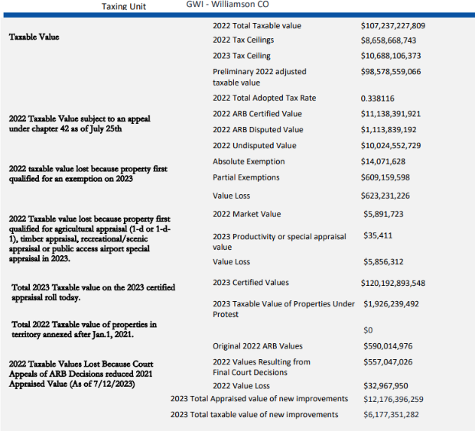

Slide 18
Extra credit info!
COUNTY TAX RATE CALCULATION WORKSHEET: 50-568
UNUSED INCREMENT RATE EXPLAINED: 98-1081
DE MINIMUS RATE EXPLAINED: 98-1083
TNT GUIDEBOOK:
https://mvbalaw.com/education-for-tax-professionals/
COMPTROLLER WEBSITE:
https://comptroller.texas.gov/taxes/property-tax/

Slide 19
What else can we talk about???
JULIE KILEY COUNTY AUDITOR JKILEY@WILCO.ORG
LARRY GADDES TAX A/C LGADDES@WILCO.ORG

